Slide 1
FOOD ORDERING APP DOCUMENTATION
PROBLEM
Kukua’s restaurant is faced with long queues every day which causes delay in serving dishes. The customers have to move from their homes and offices to the restaurant before they can get food. Some customers come and their preferred foods are not available. The restaurant is now losing customers due to poor customer experience and.
The online ordering system enables the customers to know the foods available and pre-order before they get there since the content of the app will be continuously updated. Customers can receive the food at the comfort of their homes after ordering. This will make the ordering experience easier for the customers, help reduce queues and improve the efficiency of the restaurant.

Slide 2
REQUIREMENT SPECIFICATIONS
user requirement
The restaurant should be able to display available foods and customer should be able to order food as many as they want.
System Requirement
The structure of the system requirement can be divided into three main logical components. The first component provides a menu management which allows the restaurant to control what can be ordered by customers. The second component is the web experience which allows the customers to order food. The last component is the order retrieval system whichallows the restaurant to update its content and track the orders made by customers.

Slide 3
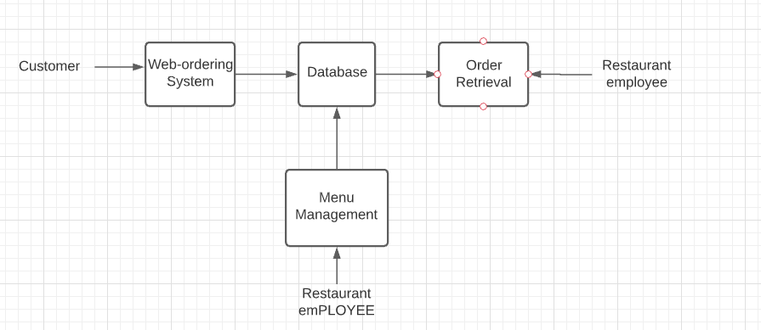
SYSTEM MODEL DIAGRAM
FUNCTIONAL REQUIREMENTS
From the above model, each of the three system components provides an isolation between the user and the database. This helps the user to interact with the interface of the app without getting access to the database. Since the user is not able to access the database, the integrity of the data is assured. Only the admin can have access to the database and also make changes.

Slide 4
WEB ORDERING SYSTEM REQUIREMENT
These functionalities can be placed under web ordering system requirement
The customer can create an account
The customer can sign in
The customer can view the foods available
The customer can order for food
The customer can modify the foods in her cart
The customer can add her address and number when purchasing
The customer can delete an ordered food if possible, all
The customer can add more food to his current order

Slide 5
MENU MANAGEMENT SYSTEM REQUIREMENT
This is used by the employees in the restaurant.
Add a new/update/delete vendor to/from the menu.
Add a new/update/delete food category to/from the menu.
Add a new/update/delete food item to/from the menu.
Add a new/update/delete option for a given food item.
Update price for a given food item.
Update default options for a given food item. Update additional information (description, photo, etc.) for a given food item.
ORDER REQUIREMENT SYSTEM
Retrieve new orders from the database. Display the orders in an easily readable, graphical way. .

Slide 6
SYSTEM DESIGN
Here, the diagrams for the main logical components which were discussed earlier on are drawn.
ACHITECTURE OF THE WEB ORDERING SYSTEM COMPONENT
This consist of six components These are the login form, the main menu, the account management form, the order form, the shopping cart, and the checkout form. When the customer visits the site, he would have to signup in order to login. After signing in, the user can now navigate through the foods available and then make an order. They can modify their shopping cart anytime. In the hoping cart, the number foods for a particular dish can be increased and the total amount is displayed. The user can now checkout when they are ready to buy. The checkout form takes the address and the number of the user.

Slide 7
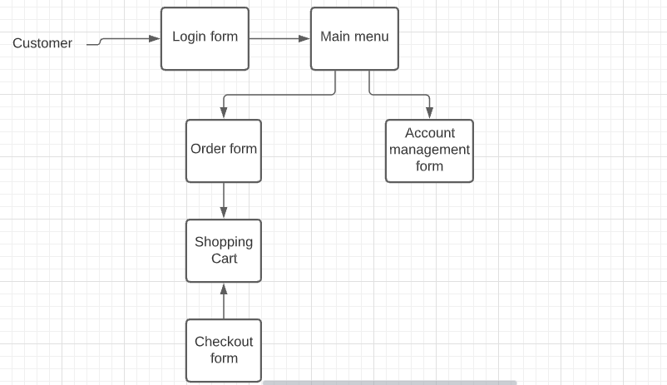
LOGIN FORM This takes the email and password of the user. The customer must register if he has no account.
MAIN MENU
Here, the foods available are displayed to the customer. The user can also view the details of the food.

Slide 8
THE SHOPING CART
It contains the foods the user has selected. Here the total amount of the food is displayed. The number of orders of a particular food can be increased or deleted here.
THE CHECKOUT FORM
The customer makes the purchasing here. The customer provides his address and number.
THE MENU MANAGEMENT
This is made available to the employees. They are able to see the categories of food and the specific food items. When an employee doubles clicks on a food item, a form is being displayed. Hence, the employee can then modify the foods available and add or remove categories of foods as well.

Slide 9
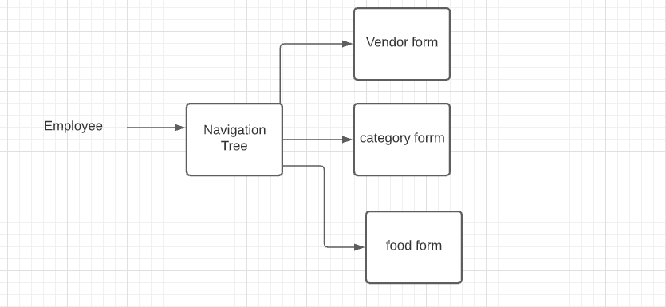
The navigation tree has 3 components. Each has its unique form. When any of them is selected, a form appears. And the employee Is able to make changes. There are three types of forms in the menu management system - Vendor Forms, Category Forms, and Food Forms. The three forms are all similar, allowing the user to add, edit, and remove information relevant to the selected item. Where they differ is in the specific fields that the user is able to edit. After changes to any of the forms are saved, the necessary records in the database are updated.

Slide 10
TESTING
WEB ORDERING SYSTEM
Testing here will be divided into two phases. During normal use case testing I will execute all of the functions available through the web interface using a broad spectrum of reasonable values that a user would be expected to input.
In phase two I will perform exceptional use case testing, where I will artificially generate cases that shouldn’t arise, but possibly could, and monitor how the system handles these cases. These cases fall into one of two categories – when the mistake happens in the browser and the server has to deal with it, or the other way around. I have tried to place appropriate checks on all values being sent back and forth so the system realizes something is wrong before going to the database and potentially changing the state of the system, but it will very important to see if there is anything I have not accounted for.

Slide 11
MENU MANAGEMENT SYSTEM
Testing of the menu management system will be very similar to that of the web ordering system, as I will first run test cases where the user supplies acceptable values, and afterwards test how the system responds to unexpected input.
ORDER RETRIEVAL SYSTEM
The only thing that will be done here is testing how the system responds when a result set is not in the form it is expecting. So we will intentionally corrupt the database and see what happens.

